Slide 1
Sentiment Analysis implementation in Drupal
Created by : Pushpendra Kumar
Presented to : GE

Slide 2
Agenda
Sentiment Analysis - Background
Benefits
System Flow
Functional Implementation in Drupal
Tools used
Question & Answer

Slide 3

Sentiment Analysis - Background
Sentiment Analysis is the process of determining whether a piece of writing is positive, negative or neutral.
It’s also known as opinion mining, deriving the opinion or attitude of a speaker. People write blog posts, comments, reviews and tweets about all sort of different topics.
Using this tool, we can track products, brands and contents to determine how they are viewed positively/negatively/neutral on the web.

Slide 4
What are the benefits of it?
It helps business in:
Flame detection (bad rants)
Product perception
Reputation enhancement
Marketing intelligence
Product and service benchmarking
It helps individuals to:
Get an opinion on content on global scale
Buy good product/service

Slide 5
System flow
Input
(Comment/Review)
Text saved
Data processing at NLP API
Sentiment in Graphs
Save Response
Classified Response

Slide 6
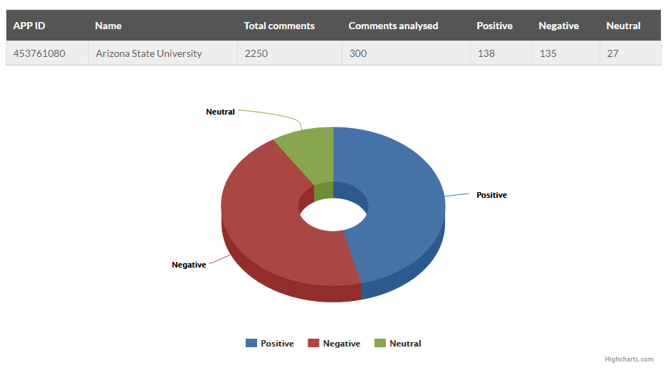
Graphical View of Sentiments
They need to include all 4 campuses
Great app for students, alumni, and teachers. Love the chant audio. Go devils!
I was not impressed with this ASU APP. While the graphics may look great it quickly deceives the purpose of keeping connected on campus.

Slide 7
Tools used
Drupal 7
Custom module
Highcharts js plugin
Sentiment Analysis API by DatumBox
http://api.datumbox.com/1.0/SentimentAnalysis.json
(Using basic free subscription for this demo, it allows 1000 calls per day.)
Other useful NLP APIs by DatumBox
Topic Classification
Spam Detection
Readability Assessment
Keyword Extraction

Slide 8
Q&A

Slide 9
Thank you

